Slide 1
Introduction to Computer Programming Lecture 2.1:
Variables & Types
Hemma Philamore
Department of Engineering Mathematics

Slide 2
Introduction to Computer Programming Lecture 2.1.a:
Variables
Hemma Philamore
Department of Engineering Mathematics

Slide 3




Variables
Variable name
Value
Assigning
Case matters!
“Age” is not the same as “age” !!!

Slide 4

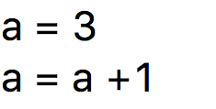
Variables
Result is overwritten!
everything on the right is evaluated and assigned to the left
variable a is assigned to value 3
a is assigned to new
value of 4
a + 1 is replaced by 3 +1 => 4
a += 1

Slide 5
Numbers in Python
Numbers
int
float
bool
complex

Slide 6
Numbers in Python
Numbers
int
5
float
1.5
int: Integer number.
float: Number with a decimal point.
complex: Number with a ’j’.
bool: True or False.
bool
True/False
complex
3+26j
capital letter
There are also bin, oct and hex
(binary, octal and hexadecimal representation)

Slide 7
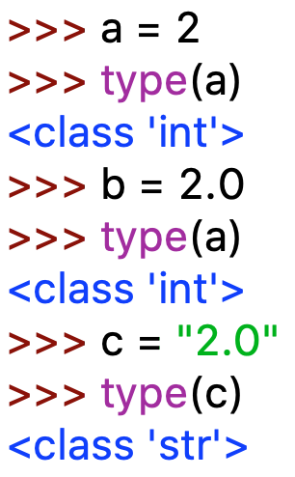
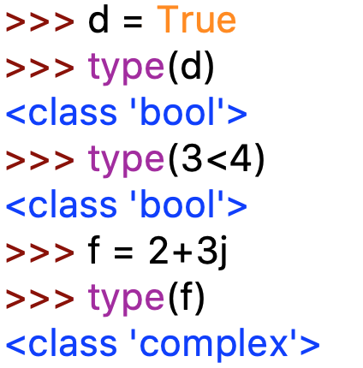
Types of variables
How does Python know what type you want?
capital letter
orange color,
IDLE recognises
it as a keyword
Decimal point
tells Python
it’s a float
>>> b = 2.0
>>> type(b)
<class ‘float’>
comparison
results in
boolean
Quotation marks tell Python it’s a string

Slide 8
Mixing types doesn’t always work
>>> a = 3
>>> type( a )
<class “int“>
>>> b = 3.0
>>> type( b )
<class “float“>
>>> d = “3“
>>> type( d )
<class “str“>
>>> e = b + a
>>> e = d + a
Traceback (most recent call last):
File “<input>“, line 1, in <module>
TypeError: must be str, not int

Slide 9
Context is important
Operators behave differently depending on the types of the operands
Some operators won’t work if they are called on the wrong type.
e.g. minus (-) doesn’t make sense for strings
>>> 2+3
5
>>> “2“ + “3“
23
>>> “2“ - “3“
Traceback (most recent call last):
File “<pyshell#34>“, line 1, in <module>
“2“-“3“
TypeError: unsupported operand type(s) for -: “str“ and “str“

Slide 10
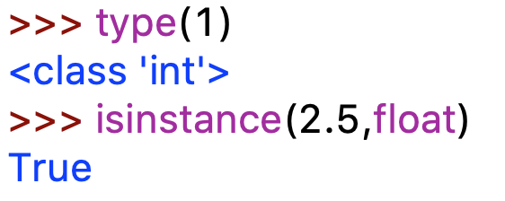
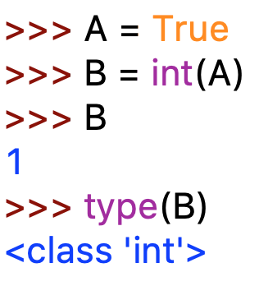
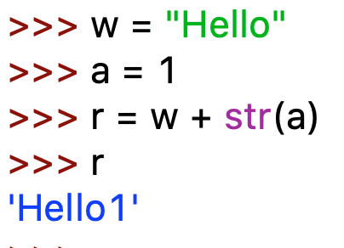
Checking and Casting Types
isinstance() and type() allow you to check types.
int, float, complex,
bool, str
You can sometimes explicitly cast types to change from one type to an other (str, float, bool)

Slide 11
Introduction to Computer Programming Lecture 2.1.b:
Operators
Hemma Philamore
Department of Engineering Mathematics

Slide 12
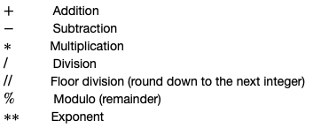
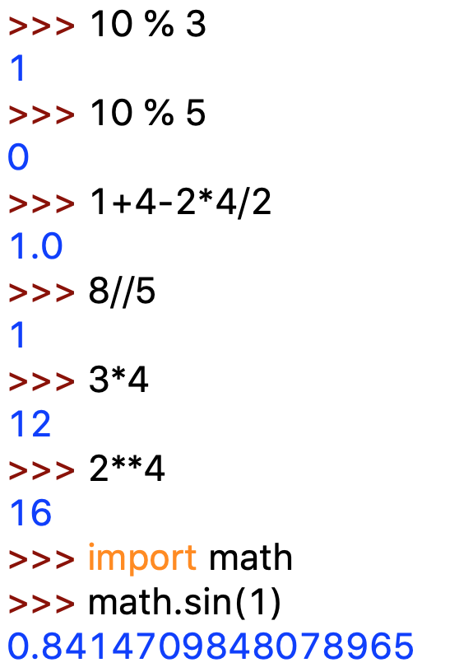
Number operators
Math operators
multiplication
% modulo
exponent
// floor division
additional functionality

Slide 13
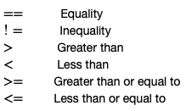
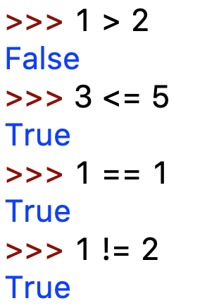
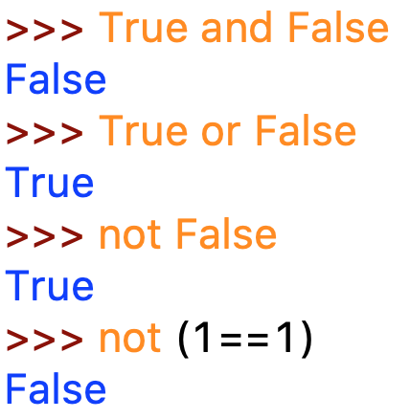
Number operators
Boolean operators

Slide 14
Number operators
Logical operators: compare the outcome of two conditionals
and : both are true
or : either are true
not: negates the outcome of a conditional
>>> (1 > 2 and 3 < 4)
False
>>> (1 > 2 or 3 < 4)
True
>>> not(1 > 2 or 3 < 4)
False
>>> not(1 > 2) and 3 < 4
True

Slide 15
Number operators
Math operators
additional functionality
% modulo
// divide and
discard remainder
Boolean operators
Note that it’s “== “and
not “=“ !

Slide 16
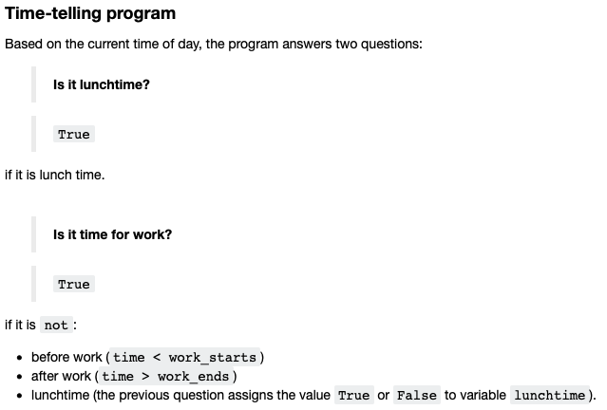

Slide 17
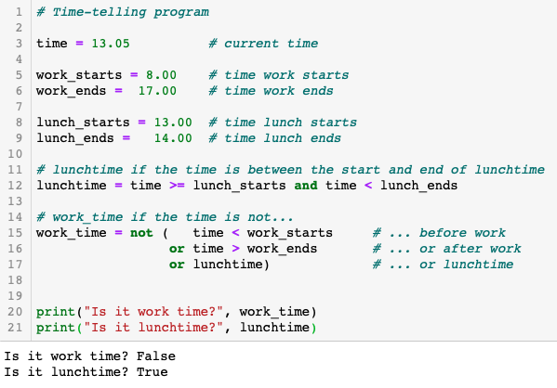

Slide 18
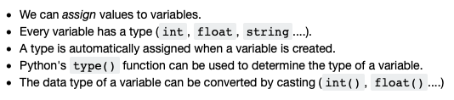
Summary
Data Types

Slide 19
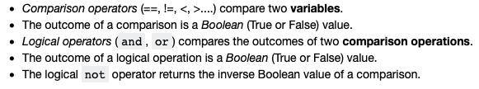
Summary
Math Operators
Boolean Operators

